Slide 1
Event driven cloud computing
Team Member: Cory McAn
Role: Developer, Tester, documentation creator
Product Owner: Jason Dettbarn of Addigy

Slide 2
Problem Definition
In the world of IT, there is great demand for a service which can:
Assist Admins with managing their client’s Mac machines
Process large amounts of data
Send real-time alerts to admins regarding issues with client machines
Do all of this without any idle servers

Slide 3
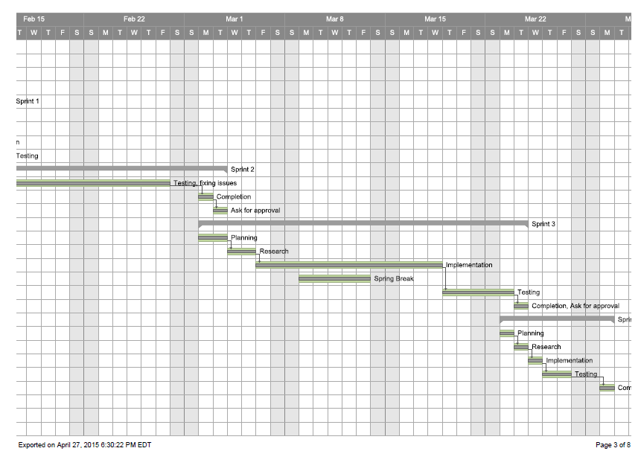
Project management

Slide 4
Requirements – User stories implemented
consolidateAuditFiles
triggerOnHarddiskThreshold
triggerOnNewThreshold
triggerNewPubNubAlert
alertAntivirusLog
triggerNewBatteryThreshold
configAlerts
runMultipleTester
dedicatedConsole

Slide 5

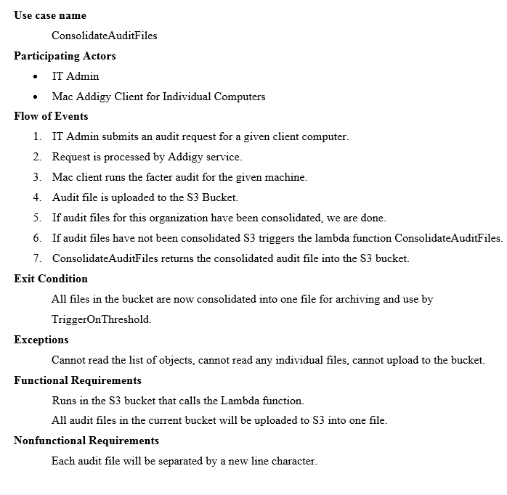
Requirements – Use Cases

Slide 6
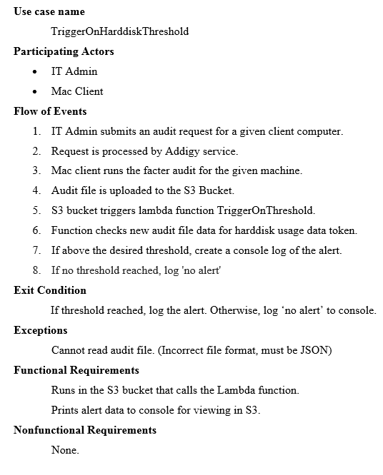
Requirements – Use Cases

Slide 7
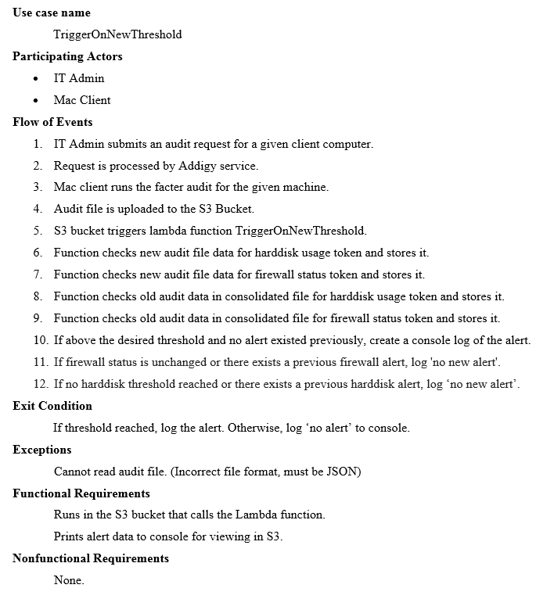
Requirements – Use Cases

Slide 8
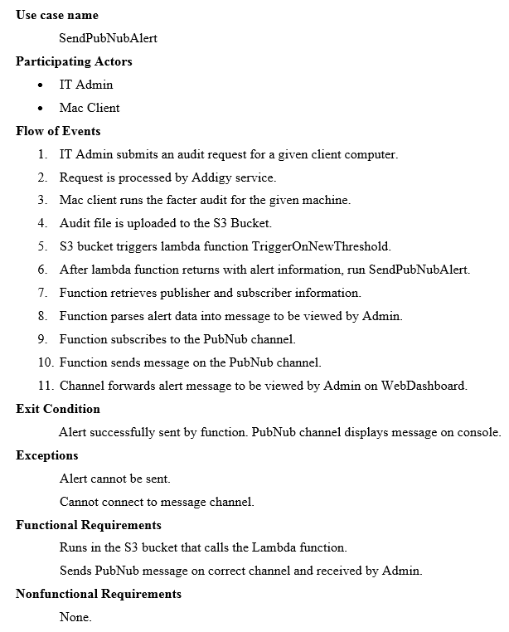
Requirements – Use Cases

Slide 9
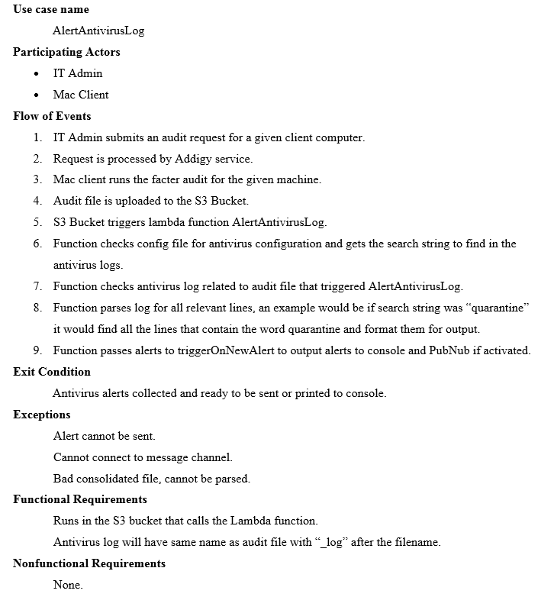
Requirements – Use Cases

Slide 10
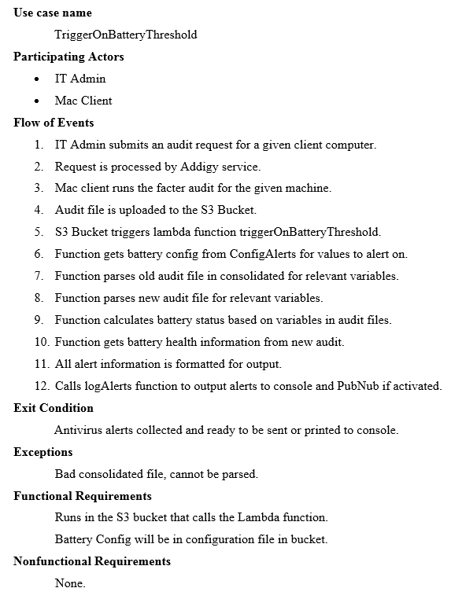
Requirements – Use Cases

Slide 11
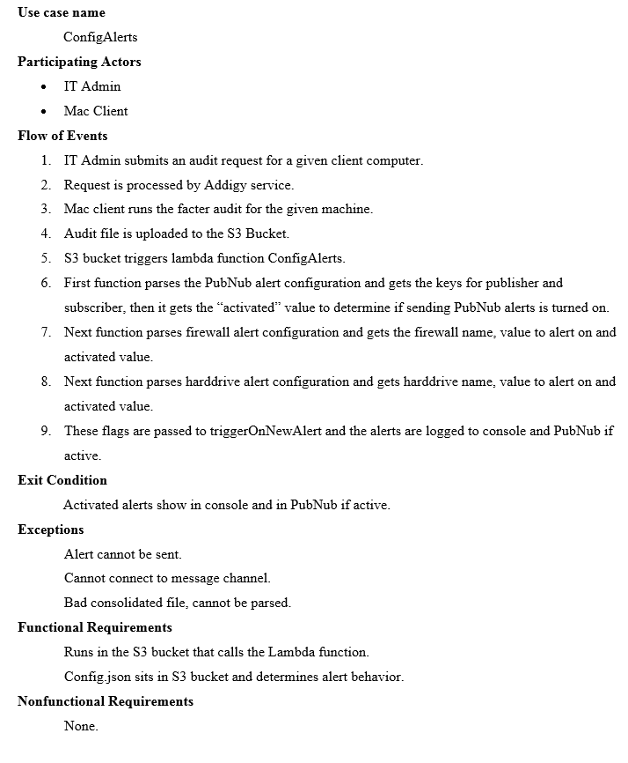
Requirements – Use Cases

Slide 12
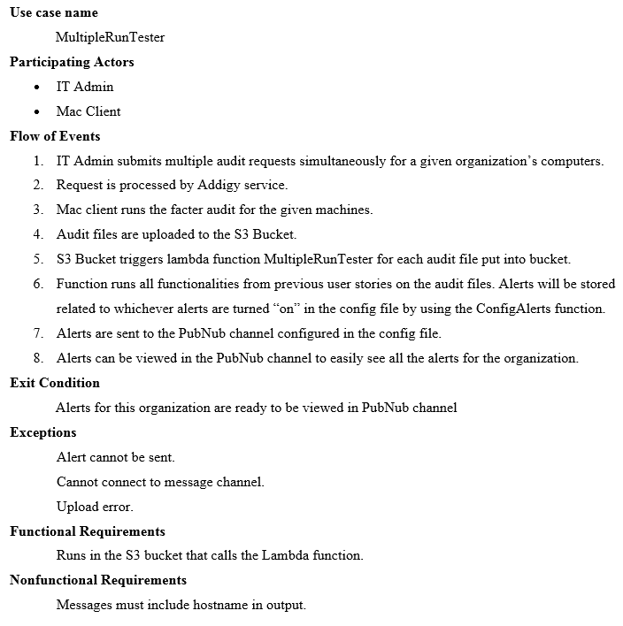
Requirements – Use Cases

Slide 13
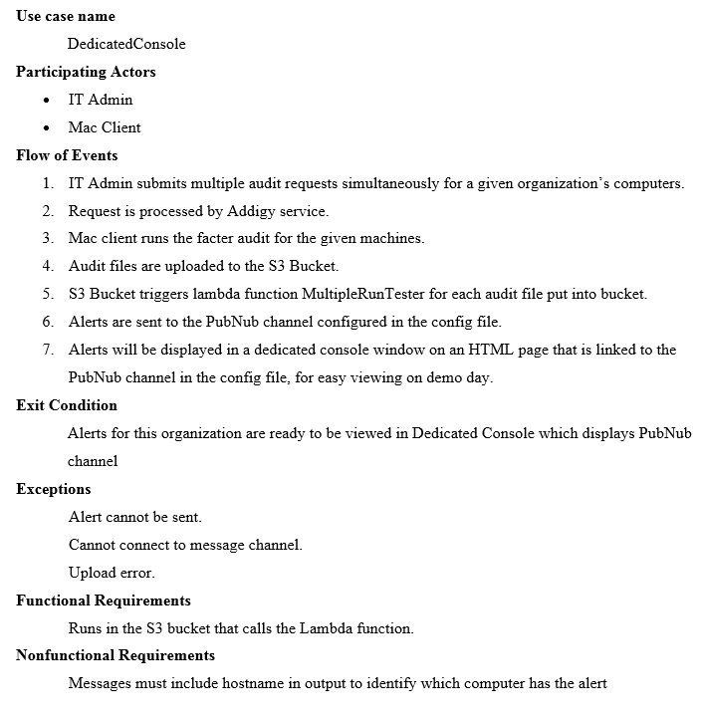
Requirements – Use Cases

Slide 14
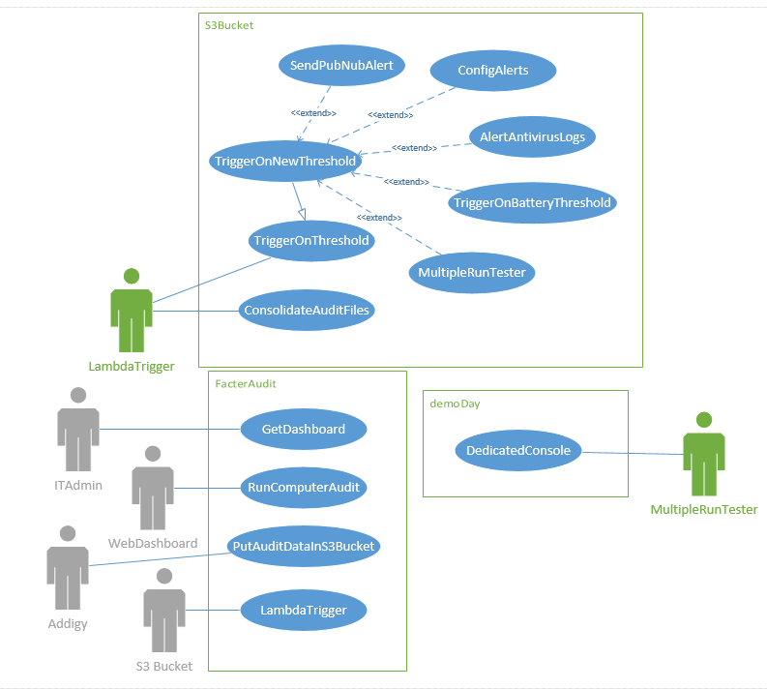
Requirements – UML Use case diagram

Slide 15
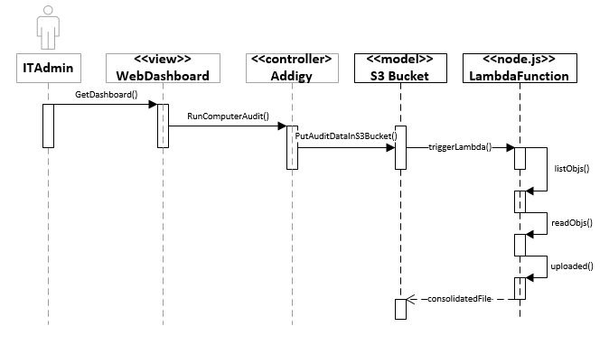
UML Sequence – Consolidate audit files

Slide 16
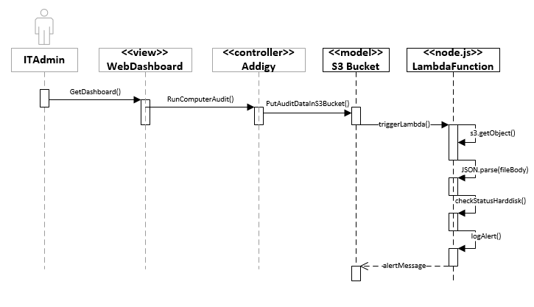
UML Sequence – trigger on harddisk threshold

Slide 17
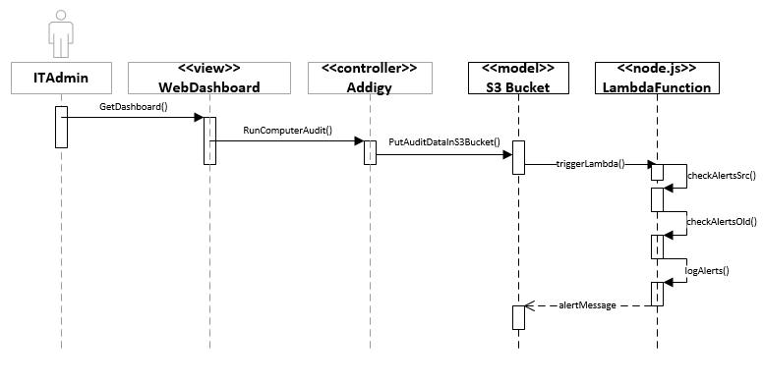
UML Sequence – trigger on new threshold

Slide 18
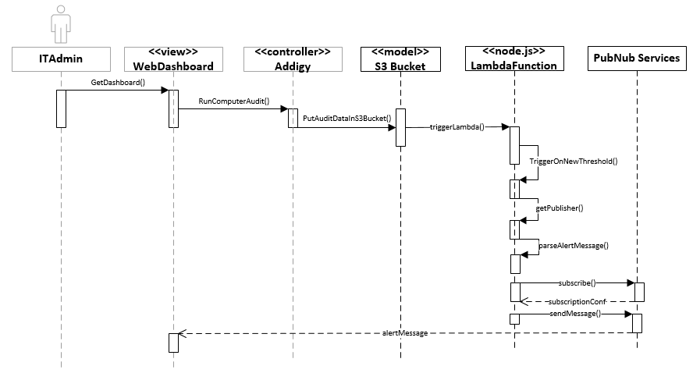
UML Sequence – trigger new pubnub alert

Slide 19
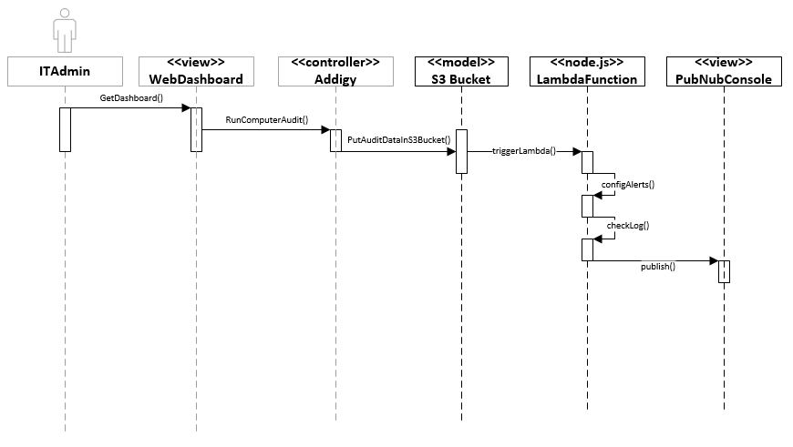
UML Sequence – alert antivirus log

Slide 20
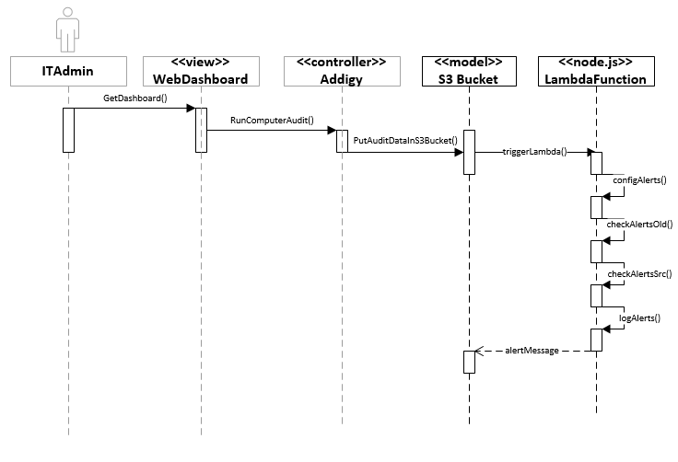
UML Sequence – trigger new battery threshold

Slide 21
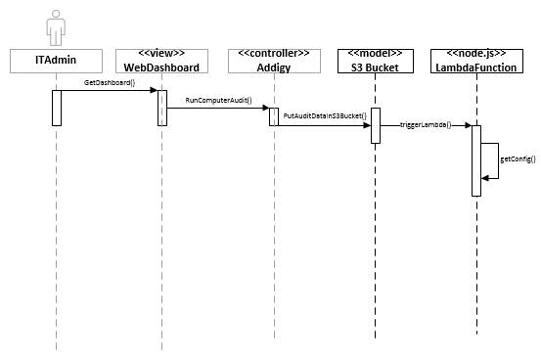
UML Sequence – config alerts

Slide 22
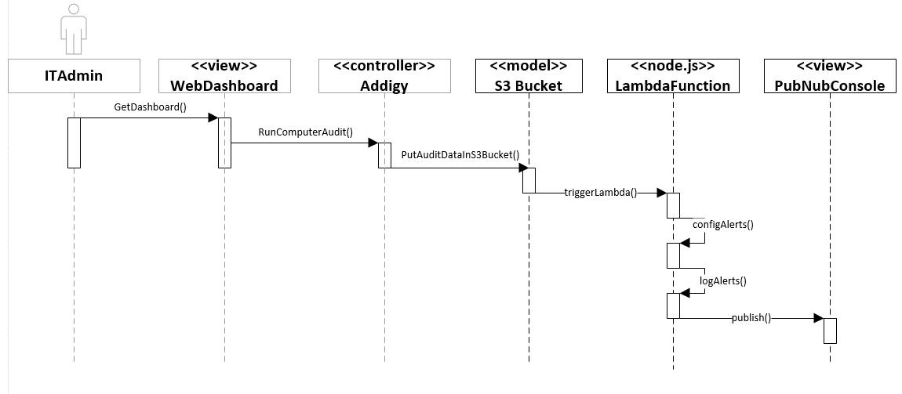
UML Sequence – run multiple tester

Slide 23
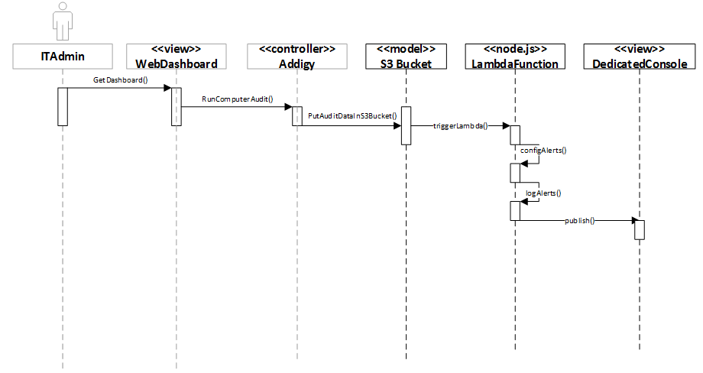
UML Sequence – Dedicated console

Slide 24
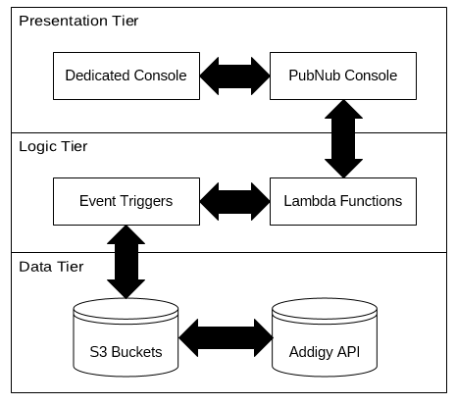
System design: System Decomposition
Three Tier System: Presentation, Logic, Data

Slide 25
System design: System Deployment
Hardware Requirements:
Software Requirements:
This project does not have any specific hardware requirements
Computation done on the cloud, not on your machine
Cyberduck
IntelliJ IDEA
AWS Manager
Node.js Interpreter
Web Browser

Slide 26
System design: Persistent data
This project does not use persistent data in this version.

Slide 27
System design: security/privacy
Security and Privacy not requested for this version
Audit data is secured by AWS S3 in the cloud

Slide 28
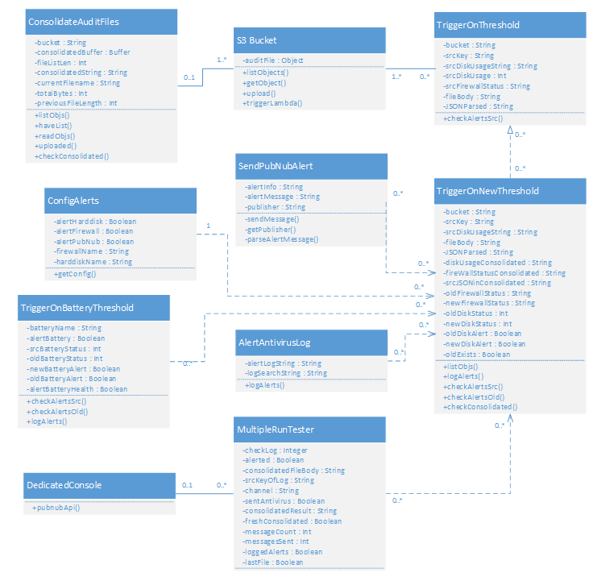
Detailed design: class diagram
Uses Model View Controller design pattern

Slide 29
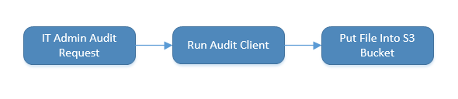
Detailed design: Main control object
The Addigy API is the main control object
Did not require modification
Involved in putting the audit files into S3 Buckets

Slide 30
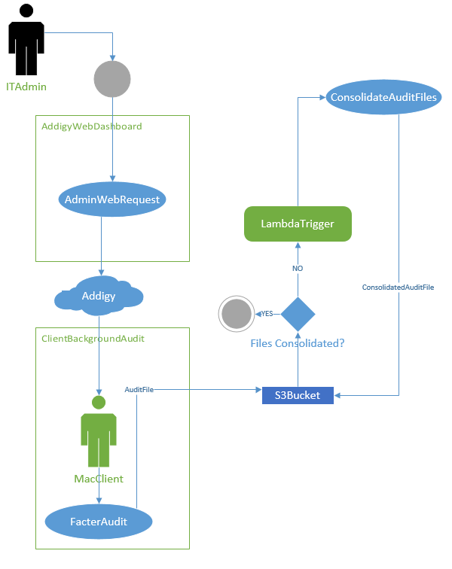
Detailed design: main algorithm - consolidate

Slide 31
Test suites and test cases
Tested by hand
Created audit files with new data

Slide 32
Test cases – Sunny day – consolidate Audit Files
Identifier | ConsolidateTest
Purpose | To ensure all audit files are consolidated in the bucket after uploading new audit files
Setup | Configure bucket event trigger to consolidation code
Input | New Audit uploaded into S3 bucket with event trigger active and Lambda Function set
Expected Output | Inside the S3 bucket where we uploaded the new file, we should see _consolidated.json. We can open and check that the values match the files that are currently in the bucket.
Identifier | ConsolidateTest
Purpose | To ensure all audit files are consolidated in the bucket after uploading new audit files
Setup | Configure bucket event trigger to consolidation code
Input | New Audit uploaded into S3 bucket with event trigger active and Lambda Function set
Expected Output | Inside the S3 bucket where we uploaded the new file, we should see _consolidated.json. We can open and check that the values match the files that are currently in the bucket.

Slide 33
Test cases – Rainy day – consolidate Audit Files
Identifier | ConsolidateTest
Purpose | To ensure all audit files are consolidated in the bucket after uploading new audit files
Setup | Configure bucket event trigger to consolidation code
Input | New Audit uploaded into S3 bucket with event trigger active and Lambda Function set
Expected Output | Inside the S3 bucket where we uploaded the new file, we should see _consolidated.json. We can open and check that the values match the files that are currently in the bucket.
Actual Output | No consolidated file output. Ran into a JSON parsing issue when attempting to consolidate the bucket.

Slide 34
Test cases – Automated scripts
The code runs in response to events
The event is typically an upload to S3
CyberDuck for batch uploads, code runs automatically on Put

Slide 35
DEMO
This demo encompasses all of the user stories completed for this project.
Link: DEMO

Slide 36
Thank you for Watching!

